Slide 1
Programming in unity

Slide 2
Variables and types
Different types
String = “This is a string” (Just a bunch of letters in one place)
Int = 24 (Ints are whole numbers, negative or positive)
Float = 24.0f (Decimal point numbers)
Declared like this:
int age = 22;
Variable type
Semicolon marks the end of a statement
Name of our variable
The value we declare

Slide 4
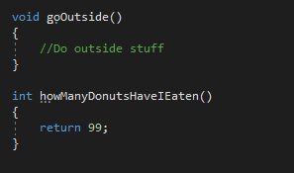
functions
Functions make the game go round!
We can declare a function anywhere within our class, and there are a few different parts:
Private void myFunction()
{
// This is a comment
}
Parentheses are our parameter list.
This is an access modifier.
The value we want to return. Sometimes void, sometimes not.
The name of our function.
Comments are declared with // wherever you want to make a comment.
Curly braces mark the body of a function.

Slide 5
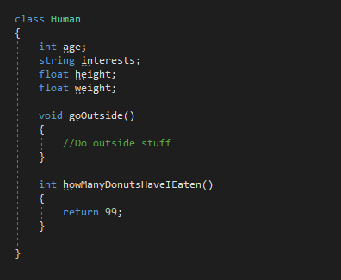
classes
Incredibly important
A class can be anything, including you!
Can contain a bunch of information about a ton of stuff
Made with the ‘class’ keyword
Usually contains variables, functions, and more!

Slide 6
Unity classes
We have specific classes that are used in Unity to make games:
SpriteRenderer – These are used to display images of GameObjects we have in our scene in 2D.
Rigidbody2D – This gives our GameObjects physics capabilities in 2D.
Transform – Comes with every GameObject, and defines the , , and scale of something.
Animator – Controls most aspects of animation that a GameObject uses such as states, transitions, and what animations to play at certain times.
position
rotation

